Slide 1
sanctuary
S.E.L.F.

Slide 2
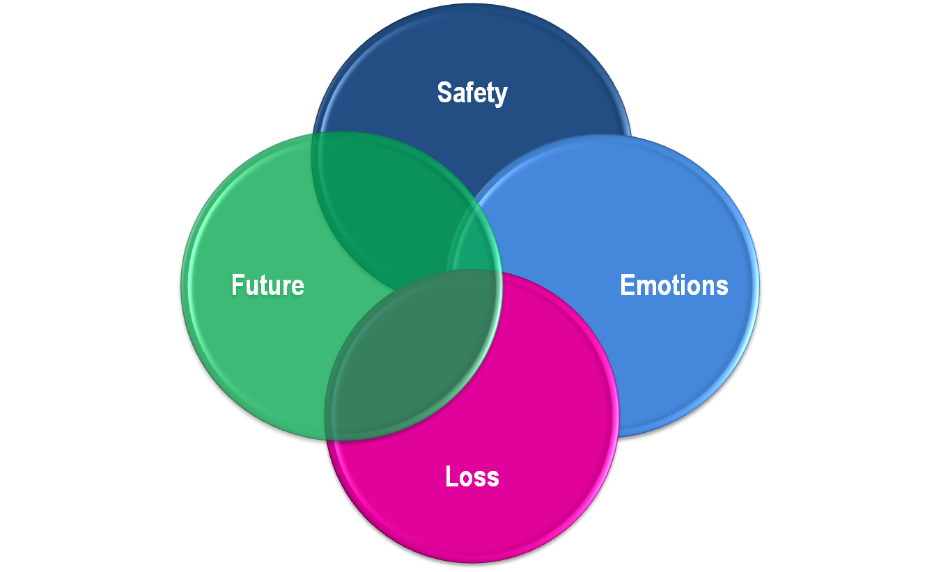
S.E.L.F.
Notes:
The SELF Model provides such a framework in that it offers four categories for focus and intervention with both clients and families and the organization itself.
It provides a simple accessible language for all of the people working together toward the change with comprehensive and universal categories:
SAFETY: physical, psychological, social and moral
EMOTION MANAGEMENT: recognizing and handling feelings in non-harmful ways.
LOSS: acknowledging and grieving past losses or traumas and committing to work against getting stuck in the past while recognizing that all change involves loss.
FUTURE: re-establishing the capacity for choice and engaging in new behaviors rather than repeating old patterns.

Slide 3
S.E.L.F.
Is a simple way or organizing complexity – helps us know where to start.
Dynamic and non-linear. Phases you move in and out of, rather than stages you climb.
Is a simple and accessible language. We can all be on the same page.
Can apply to individuals as well as organizations and groups.

Slide 4
Domains of safety
Physical Safety: Your body is safe from physical harm.
Psychological Safety: You are safe with yourself.
Social Safety: You are safe with others.
Moral Safety: You and your community are safe and consistent with your conscience, beliefs and values.
Notes:
PHYSICAL: No violence to others in any form: physical, emotional, verbal, or sexual.
Absence of suicidality/self-destructive behavior.
Absence of substance abuse.
Healthy, safe, relational sexual behavior.
Avoidance of risk-taking behavior.
Good health practices.
Healthy, nonviolent disciplinary practices.
PSYCHOLOGICAL: Self-protection. Self-esteem. Self-empowerment. Self-control. Self-discipline.
SOCIAL: Safe attachments. Safety in the group. Social responsibility. Exercise of responsible authority.
MORAL: Do the right thing.

Slide 5
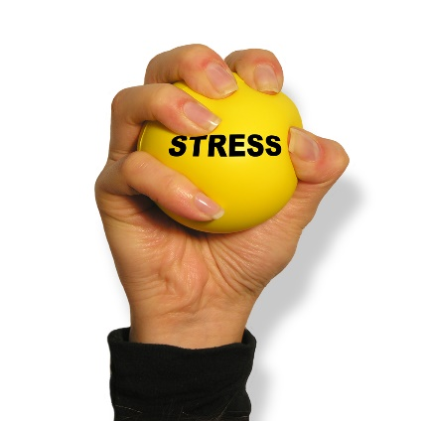
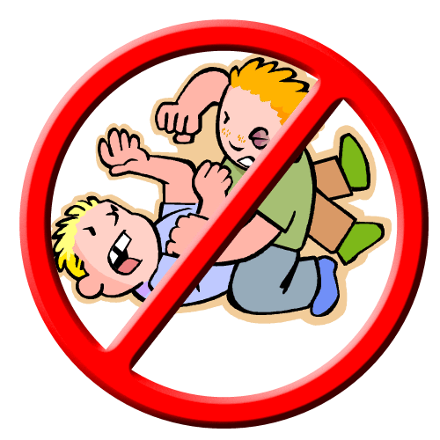
Emotion Management
Giving words for feelings
Neither expressing nor suppressing; but managing
Trading in actions for words

Slide 6
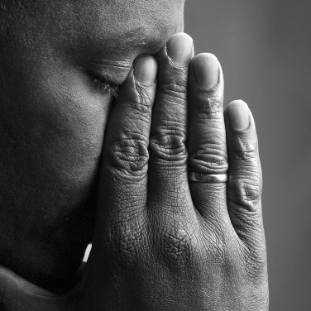
Loss
Moving on
Grieving
Saying goodbye
Refraining from reenactment
Notes:
Grieving – acknowledging the past.
Saying good-bye – developing rituals or rites of passage.
Moving on – beginning to plan for the future.
Refraining from reenactment – disrupting old and dysfunctional patterns.

Slide 7
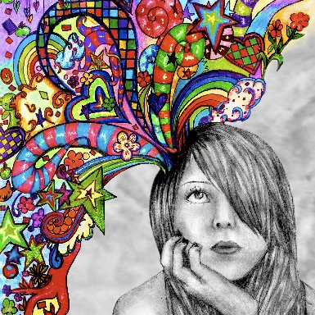
Future
Imagination and Vision
Changing trajectories
New attractors
Different choices
Notes:
Changing trajectories – disrupting past behaviors.
New attractors – finding inspiration that pulls you toward something better.
Making different choices – being active rather than passive.
Imagination – believing that things can be different.
Vision – taking time to think about what can and will be different.

Slide 8
Seabiscuit
Seabiscuit is a film about an “underdog” horse who goes on to accomplish great things. The following scene introduces the horse and describes the horse’s history growing up.

Slide 10
Seabiscuit
Many people overlooked the horse. Finding the right jockey to work with him and finding the right strategy was the first step toward his success.

Slide 12
Discussion
What were the SAFETY issues? What was his EMOTION MANAGEMENT? What LOSSES did he experience? How was his FUTURE looking?
What was Seabiscuit like before the trauma(s) occurred?
What happened to him?
How did he react to the trauma(s)?
What would you do to help him heal from his traumatic past?
Notes:
In this film clip, Seabiscuit experiences a number of kinds of trauma: being separated from his mother, losing his family, and being hit (abused) by trainers, etc.
As a result of his traumas, Seabiscuit experiences depression, lack of interest in activities, anger, irritability, and he feels “on edge”. It is hard for Seabiscuit to trust others.
Sometimes people who experience trauma feel angry and may act with aggression or violence. A common phrase to describe this is “hurt people, hurt people.” In this scene, Seabiscuit and the Jockey are both aggressive with others because they have been hurt. People who have been hurt often need loving care in order to recover from their traumas.

Slide 13
Closing thoughts
By focusing on four very simple components, SELF frames our conversations, and allows us to touch on the very complicated issues the individuals and communities face.

Slide 14
