Slide 1
sanctuary
Toolkit

Slide 2
The Sanctuary toolkit
Notes:
Community meetings are a tool to bring groups of people together and allow an opportunity to take the pulse of the group before beginning a meeting.
The community meeting is not a therapy group, but a short check-in in which you are able to connect with others and identify issues that may support or impede your work together.

Slide 3
Community meeting
Notes:
Each question is designed to meet a specific goal:
Provide a way to structure time together
Create a healthy and predictable routine for the community
Models caring for each other
Building bridges from the present to the future in setting goals
Reinforces the power of the circle – the idea of shared responsibility for each other and the community serves as a way to establish some safety within the group by allowing each person to participate.

Slide 4
Community meeting
How are you feeling today?
What is your goal for today?
Who can you ask for help?
Thought for today
Notes:
The first question is “How are you feeling?” The purpose of this question is to reinforce the importance of recognizing emotions and managing them. When used with clients or with staff, the question helps members gauge the emotional functioning of those in the group. The answers to this question may lead your group to recognize that it needs to address issues or tensions that may not otherwise be addressed.
The second question is “What is your goal for the day (or meeting, or morning, etc.)?” The purpose of this question is to keep a focus toward the future. People who have experienced trauma often become stuck in the past and have difficulty envisioning the future. This question requires that participants build a bridge from the present to the future.
The third question is “Who will you ask for help?” The purpose of this question is to build relationships among participants. Some goals may require help from someone outside of the group. Whenever possible, participants should look to other members of the community meeting to help with their goals. Many people rely on a spiritual practice or belief to meet their goals. Although this should be respected, we encourage participants to also look to another person in the room or in the community in order to meet the goal of this question.

Slide 5
Community meeting
Can be adapted or change up the questions to keep community meetings fresh.
What color are you feeling like today? And why?
What type of amusement park ride do you feel like today? And why?
What weather best describes you today? And why?

Slide 6
Community meeting
Sticky Issues:
“I don’t want to participate”
“I don’t feel anything/I don’t know how I feel”
“My goal is to get the F out of here OR to hurt myself OR to hurt someone else”
Notes:
I don’t want to participate: Keep in mind that the community itself is likely to pull the individual along in participating OVER TIME; and that power struggles will likely defeat the purpose. Staff and peers may want to check in with that person later.
I don’t feel anything/I don’t know how I feel: It might make sense to offer an observation about the person’s body language as a hint to their feelings. Offer a feeling chart – some individuals may need help putting feelings into words.
My goal is to get the F out of here/hurt myself/hurt someone else: Think about referring back to the feeling expressed in the first question and ask to check in about what may have happened. Think about referring the individual to his/her safety plan. It is also okay to offer responses like, “I’m worried about you and I’m going to check in after this to figure out how to help you stay safe.”

Slide 7
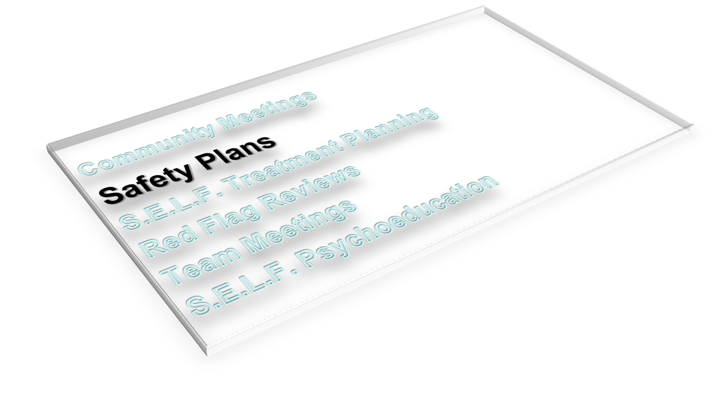
The Sanctuary toolkit

Slide 8
What is a safety plan?
A list of activities that a person can choose when feeling overwhelmed so that he/she can avoid engaging in unsafe behavior in the moment.
Count backwards
Listen to music
Call my sister
Take a walk
Notes:
Safety plans are a visual and concrete reminder for both staff and individuals about the need for each individual to manage emotions in the service of keeping themselves and others safe.
Safety plans should include both activities that one can do alone as well as those that involve others.
The activities should be appropriate to the time and place (ie: leaving to get a coffee when you are the only staff on duty would not be appropriate.)

Slide 9
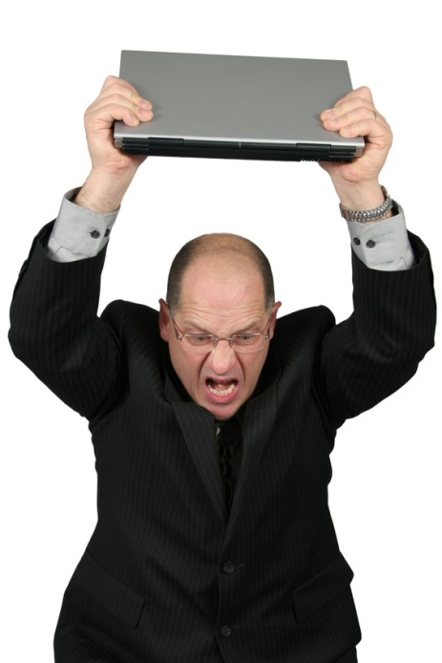
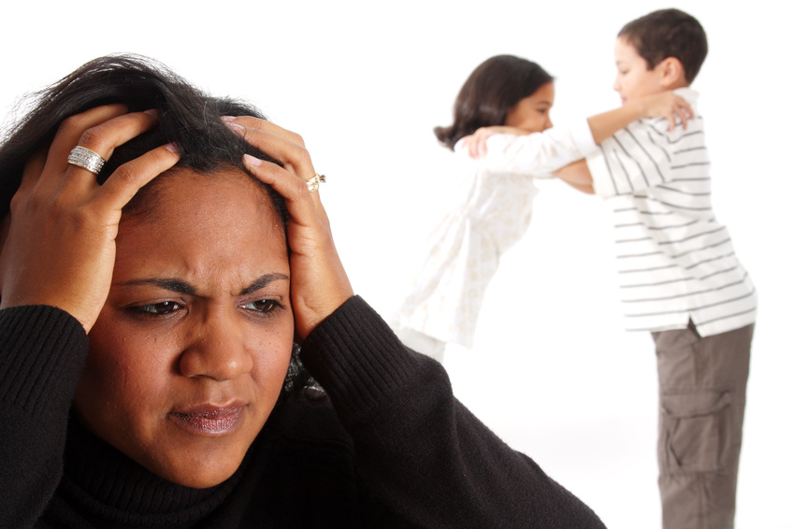
Why are safety plans important?
Safety Plans keep people safe by helping to regulate emotions.
Notes:
Safety plans serve the purpose of maintaining safety through emotion management.
It is often a good place to start when making a safety plan to identify what types of emotions are most difficult for you to manage – it may not only be anger, but sadness or anxiety that require the use of a safety plan.
It is also wise to think about the specific triggers that may stimulate these emotions in you.
The exercise of creating a safety plan can be a lesson in emotional intelligence.

Slide 10
Domains of safety
Physical
Social
Psychological
Moral
Notes:
Most of us only think of physical safety, but it is worth examining the others as well, since sometimes our unsafe behaviors are more likely to be on one of the other categories.
Physical: keeping our bodies safe (not hitting or destroying property)
Social: being safe with others (not teasing, name calling or shaming)
Psychological: being safe within ourselves (not becoming suicidal or participating in negative self-talk)
Moral: being safe to do the right thing (not keeping a harmful secret or colluding with someone who is doing something wrong)

Slide 11
What are “self-regulating options”?
You can do them yourself
They are RELATIONAL tools
They can be done anytime, anywhere!
Examples: Breathing, silently counting backwards, massaging one’s hands, silent prayer
Notes:
Safety plans are a list of activities that help us to refrain from becoming unsafe in any of the ways listed above by employing self-regulating options, things that help you manage your emotions.
The list should include things that you can easily do for yourself.
Making a safety plan, wearing it or carrying it in some way and using it by engaging the help of others encourages a sense of community and builds relationships.
The safety plan list should have at least some activities that can be done anytime and anywhere (deep breathing, muscle relaxation, squeezing your hands together, putting your hand on your heart to feel your heartbeat, silent prayer, etc.)

Slide 12
Mirror neurons
Individuals who struggle with managing emotions learn from adults who can manage their emotions.
Notes:
Safety plans are a tool that are to be used by both clients and staff. Why do staff have to wear them too?
Staff members are just as vulnerable to experiencing overwhelming emotions in the overwhelming environments we work in.
Part of the work of creating a trauma-informed culture is to model emotion management skills for others.

Slide 13
What children see…
Notes:
Please remember to warn participants that this video can be a little intense.

Slide 14
KEEP
CALM
AND
USE YOUR
SAFETY PLAN

Slide 15
Red flag meeting
Anyone in the community – including the individuals – can call a Red Flag Meeting to respond to a community need or concern.
They are short meetings in which most of the focus is on coming up with SOLUTIONS.
It is based on the idea that many people coming together to address a problem are more likely to come up with innovative solutions (shared governance).
Notes:
If you are invited and are working, you are obligated to go.
The team discusses the incident, the individual’s history in relation to the incident, factors contributing to the problem and makes a plan for a response.
People in the room are assigned tasks and report back at the next meeting about progress.

Slide 16
Red flag meeting
It is based on the idea that many people coming together to address a problem are more likely to come up with innovative solutions (shared governance).
Sometimes voicing a problem with a team relieves unspoken tensions or fears – the problem may not be the individual’s, but the team’s problem.
It places the responsibility of working through the problem on the entire team.
Notes:
If you are invited and are working, you are obligated to go.
The team discusses the incident, the individual’s history in relation to the incident, factors contributing to the problem and makes a plan for a response.
People in the room are assigned tasks and report back at the next meeting about progress.

