Slide 1
Sanctuary
Trauma Theory

Slide 2
Trauma Disrupts attachment
“I was forced to chose between my mother and father.”
“My neighbor beat the shit out of my cat.”
“My father stole us from our mother.”
“A bullet went through our car window.”
“My mother would leave me alone for days at a time.”
“Our mother tried to murder us.”
“I almost died when a bus smashed into our car.”
“My father was arrested over death threats.”
“I watched my father run over a helpless kitten.”
“I witnessed a plane crash.”
“My father went missing for nine months.”
“I almost drowned in a pool.”
“My babysitter touched us inappropriately.”
“I jumped out a window to escape my father.”
“My brother was hit by a drunk driver.”
“My brother committed suicide.”
“A tornado tore down my house and knocked me unconscious.”
“My sibling physically abused me.”

Slide 3
Trauma and attachment
Interferes with a child’s ability to have a safe and healthy attachment to a caregiver.
Research has demonstrated that attachment is the building block of all of our other human relational functions.
When attachment is disrupted, that disruption has a cascading effect on many other human functions:
Emotion management
Behavior
Relationships
Self care, etc.

Slide 4
Attachment trauma
A child may experience a feeling that a caregiver is unavailable during a time of crisis.
Story: Man asks why 100 babies in an orphanage aren’t crying.
Notes:
While visiting an orphanage in Uganda, he walked into a nursery with over 100 filled cribs with babes. He listened in amazement and wonder as the only sound he could hear was silence. A sound that is beyond rare in ANY nursery, let alone a nursery where over 100 babes laid.
He asked how it was possible for a nursery to be so silent.
After about a week of them being here, and crying out for countless hours, they eventually stop when they realize no one is coming for them.

Slide 5
Attachment and abuse
Cessation of abuse does not necessarily change relational imbalances and dysfunction in families.
This changes the way a child thinks about the world: a working model of how people interact, treat each other and behave.

Slide 6
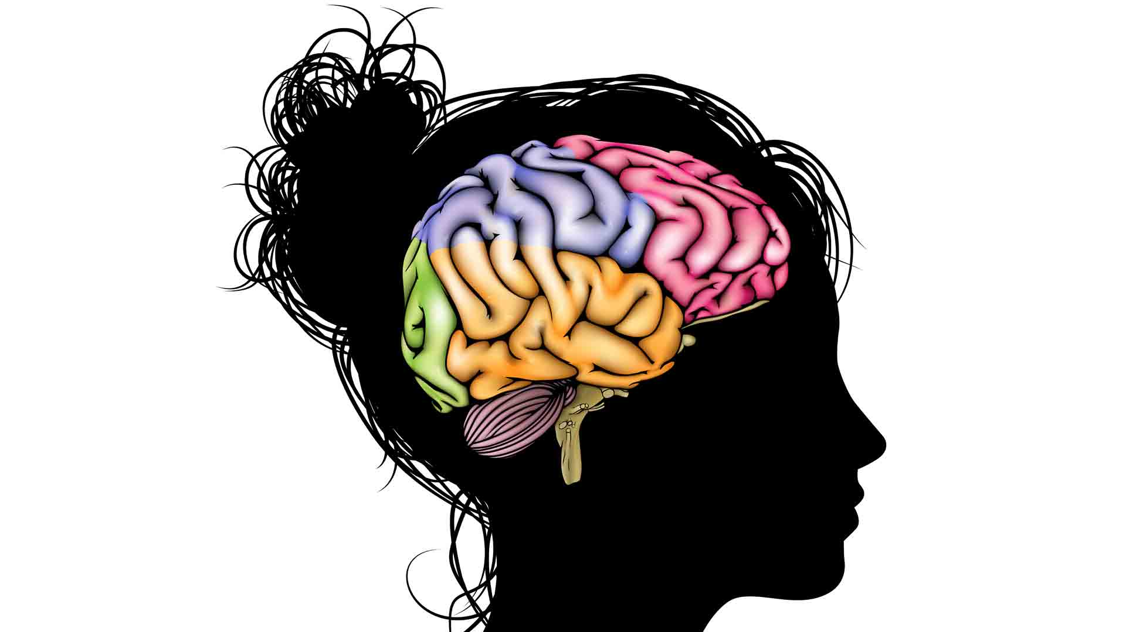
Trauma is the central problem

Slide 7
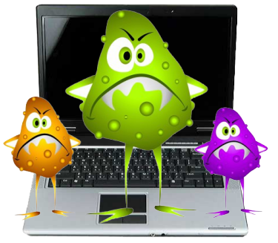
What does a virus do to your computer?
This is what trauma does to the brain.
Notes:
Trauma can disrupt the operating system to the point where multiple functions are impaired.

Slide 8
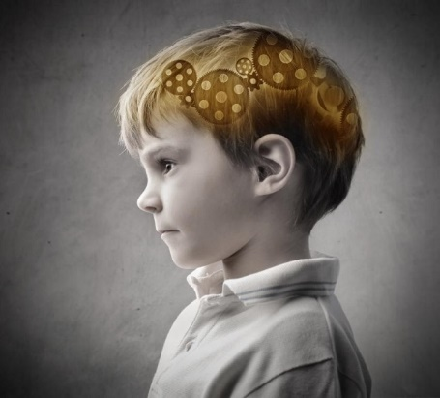
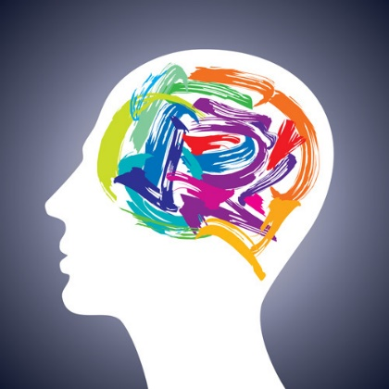
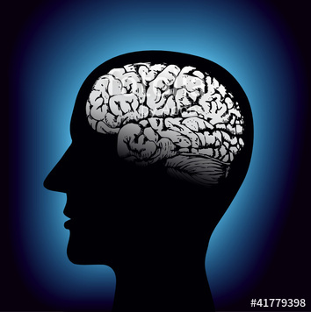
Trauma alters the brain
Most brain development occurs after birth.
Experiences shape the brain’s development.
Trauma can change the brain’s structure while it is still growing.
Notes:
Human brains do most of their development after birth, making us vulnerable to the effects of early disruptions and traumatic experiences.
Human brains are also incredibly malleable – experiences shape the brain’s development even more than genetics, meaning that trauma can change the brain’s structure while it is still growing.
The rapid growth that happens in early childhood also leaves humans vulnerable to the realignment of neurons.

Slide 9
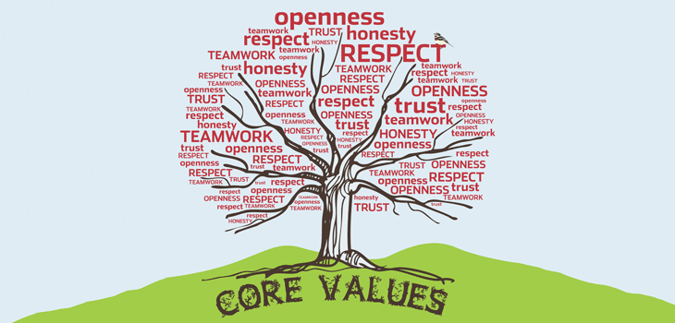
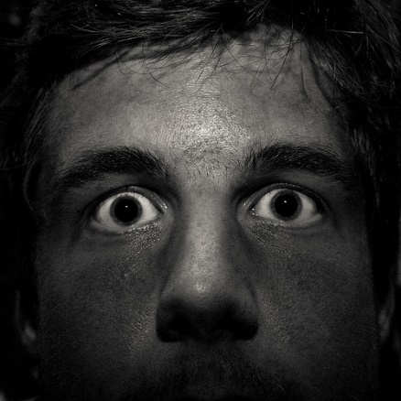
Trauma alters the brain
By age 10 a child’s value system is already embedded in the brain.
Chronic stress or crisis floods the brain with stress hormones.
This creates a state of “chronic hyperarousal”.
Notes:
As a child grows, the brain becomes more and more hardwired and less elastic. If a child has experienced abuse or neglect, that value system will have been influenced by those incidents.

Slide 10
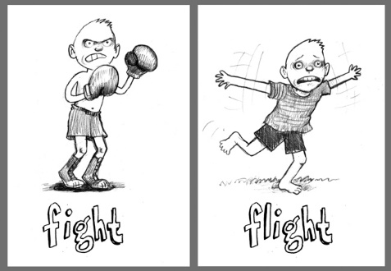
The brain and body reacts with the most basic survival skills
Stand your ground.
Defend your position.
Attack.
Dig in.
Persevere.
Give way.
Retreat.
Discard.
Remove yourself.
Give up.
Move on.
Notes:
In this state of chronic hyperarousal, the brain and body react by relying on their most basic survival skills.
Unfortunately, these survival skills seem out of context for the situations and can result in what appears to be very dysfunctional behavior.

Slide 11
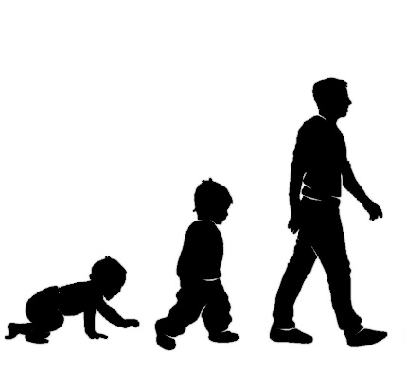
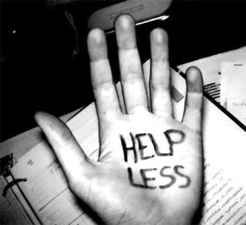
Trauma alters the brain
Interferes with normal emotional & cognitive development.
Emotional states are too intense to handle.
Reinforced by helplessness and need for control.
Notes:
We may see problems with judgment, mood and behavior.
Exposure to extreme emotional responses – often too intense for the brain to tolerate. Traumatized people may seem numb to distressing experiences to which other people respond strongly. Instead of showing what they feel, they may act-out what they feel resulting in a wide variety of behavioral disturbances.
May develop a sense of helplessness created by the inability to stop the trauma. This may result in controlling behaviors as way to mitigate that sense of helplessness.

Slide 12
Poor emotional management leads to:
EXTERNAL SYMPTOMS
Substance Abuse
Violence
Self-Harm
Risk Taking
INTERNAL SYMPTOMS
Dissociation
Alexithymia
Flashbacks
Nightmares
Body Memories
Traumatic Reenactment
Notes:
The external symptoms tend to be the ones that signal distress to the outside world and result in referrals to treatment, but the internal symptoms are less easy to see, but just as dangerous.
Will expand on the internal symptoms on the following slides.

Slide 13
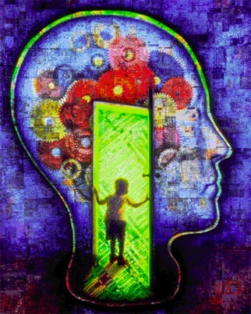
Dissociation
The brain’s self protective “checking out” response.
Survivors of trauma inhabit their head and lose contact with their body.
Frequent detachment from bodily experiences results in loss of reality, and uncertainty about whether the experience actually happened.
Dissociation is a form of emotional anesthetic to aid survival.

Slide 14
Dissociation – why?
Our major organs are tied to our emotions. It is possible to be scared to death.
Allows us to go through an overwhelming experience without feeling so distressed that we are unable to respond or protect ourselves.

Slide 15
Dissociation Continuum
Daydreaming
Dissociative Identity Disorder
MILD
SEVERE
Notes:
Ask the group if they’ve ever driving somewhere and when they got there, couldn’t remember what route they took; if they stopped at the stop sign; etc.
Or taken a shower and couldn’t remember if they’ve washed their hair already.
Dissociative Identity Disorder: Also called multiple personality disorder – it is an extreme trauma response in which a child unknowingly creates other personalities/identities as a way of coping with traumatic experience, and then as the child develops these personality splits remain in place.

Slide 17
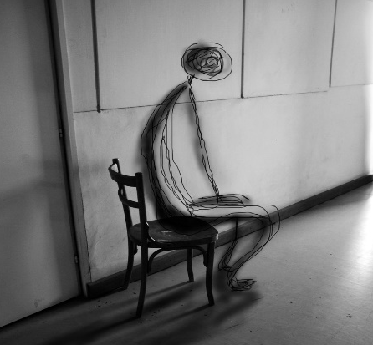
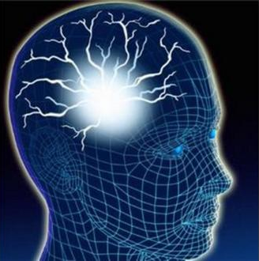
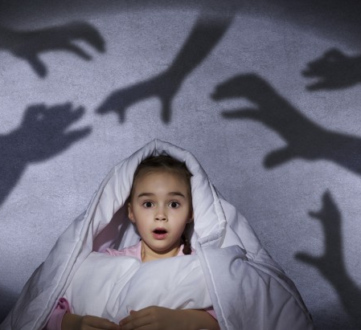
Other forms of dissociation
Alexithymia
A person is disconnected from his/her feelings.
Flashbacks
Re-experiencing the trauma as if it were happening in the present moment.
Nightmares
Disrupted sleep and
re-experiencing the trauma in dreams.
Body Memories
Feeling pain or physical sensations in the body in response to trauma.

Slide 18
Traumatic reenactment
Without a belief that things might ever be different, human beings will continue to repeat the past and may do so throughout their lives.
Putting trauma aside for a moment, we repeat our past because we are creatures of habit. Whatever we did kept us alive today, it probably will keep us alive tomorrow.
Notes:
Think about the way that you get to work every day. Chances are that you follow the same routine every morning from what you do when you first get out of bed, to the order of getting dressed and making your coffee. That is because the familiar is comfortable. And these routines and habits actually help us to be more functional in the long run.

Slide 19
Traumatic reenactment
When what is familiar to a traumatized person is dangerous or harmful, repeating patterns can make them less functional.
If they are used to “fight or flight” they will apply this to everyday stresses – even though there may not be any real threat.
Notes:
Because traumatized people are so vulnerable to stress, even minor stresses like frustration over a math problem can throw their bodies into a “fight or flight” response so that they experience a serious threat.

Slide 20
Exposure to stress makes us all vulnerable to reenactment
The people we treat don’t have movies about their lives that we can watch.
But they do have “scripts”.
Reenactment doesn’t just happen in behaviors.
It also happens in relationship dynamics.
Notes:
If we don’t know their experiences, we may interpret reenactments as other types of symptoms: psychosis, suicidality, etc. Because trauma changes the brain, and influences attachment and relationships, it also changes the way that traumatized people expect others to react and respond to them.

Slide 21
Reenactment triangle
Victim
Persecutor
Rescuer
Notes:
When traumatic experiences are acted out in relationships, people usually fall into one of these three roles.
VICTIM: Becoming helpless, incompetent, oppressed and hopeless.
RESCUER: Working hard to help someone else but are often feeling martyred, guilty, angry under the surface, and may be considered meddler by others.
PERSECUTOR: Operating from a position of some kind of power, tend to bully, find fault, accuse others, led by threats, and are often blaming and shaming.
Because reenactment of trauma is unhealthy for our clients (and for us!) we do not want to fall into any of these roles.
Although being a rescuer sounds more appealing than the other roles, we can never rescue our clients from their past trauma because it has already happened! Our work is to help them break those patterns and re-script their futures.

Slide 22
Our role in reenactments
We have our own histories, our “stuff” can sometimes intersect with their “stuff”.
By being in their reenactment we experience it ourselves.
We have to be very aware of our own visceral reactions because we can get pulled in unconsciously…
Notes:
This does not mean sharing our trauma histories with our co-workers or clients, but being aware of the things that are likely to make us feel like victims, persecutors or rescuers.

Slide 23
Reenactment
A child who has a long history of sexual abuse was told by his social worker that she would have to go to the doctor. This appointment was particularly important, since the child is diabetic and had recently had surgery. Without proper medical care, the child could potentially lose his leg. The social worker was adamant that the child go to doctor, knowing that this was in his best interest. Rather than understand that the social worker was trying to help him, he responded with severe aggression, grabbing the worker’s hair and throwing her to the ground. Other staff came to help and ended up physically restraining the child.
Notes:
How is this reenactment?
Who was the persecutor? Victim? Rescuer?

Slide 24
So what do we do?
We teach the individuals about it and our staff so that we can recognize it.
We use Sanctuary language to describe reenactments rather than blaming language.
We give them a different experience.
“What’s happened to you?” vs. “What’s wrong with you?”
We stop recreating their trauma by changing our behavior and language.
How we talk with each other.
Notes:
Because traumatized people are so vulnerable to stress, even minor stresses like frustration over a math problem can throw their bodies into a “fight or flight” response so that they experience a serious threat.

Slide 25
Discussion
Describe the history of the individual, including what you know about traumatic experience.
How might you understand some of this person’s behaviors in relation to his or her experiences?
How might your understanding of these behaviors change the way you deliver services provide treatment to this person?

Slide 26
Necessary framework
Many treatment models offer stages to follow to help a client progress through treatment.
Research has shown that linear models for change just don’t work very well.
We need a model for structuring change that appreciates the non-linear nature of change.
Notes:
Because traumatized people are so vulnerable to stress, even minor stresses like frustration over a math problem can throw their bodies into a “fight or flight” response so that they experience a serious threat.

